Slide 1
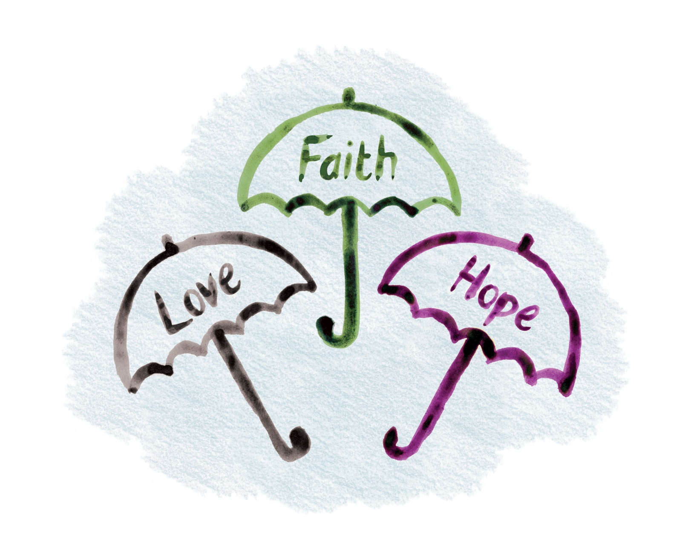
The Christian faith that underpins
the “What If Learning” approach
What If Learning: Connecting Christian Faith and Teaching
Notes:
Title slide

Slide 2
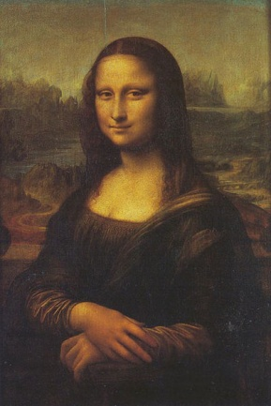
Shaped by Faith
Shaped by faith
Learning within
a Christian framework
http://www.gutenberg.org/files/18900/18900-h/images/image_121_1.jpg
What If Learning: Connecting Christian Faith and Teaching
Notes:
What you see in the examples on this site is a pedagogy that has been profoundly shaped by Christian thinking, even though the content of Christian faith is not necessarily visible. Pedagogy is a little like the frame of a painting. The frame is not the painting, but it can enhance our experience of the painting, using the wrong frame can distort that experience (imagine the Mona Lisa in a pink, oval, plastic frame). In education, pedagogy creates the thinking framework within which teaching and learning takes place in a way that is in line with a Christian ethos.
How does pedagogy provide a “frame” or “framework” for teaching and learning? It might provide a framework of justice when looking at reform in history, or a framework of integrity and wonder in science. Faith might provide the framework of people as “made in the image of God” for civics or as “stewards of God’s world” in environmental science. That means, for example, that integrity and wonder form the acknowledged mental framework within which science happens, and people as “stewards of God’s world” becomes the acknowledged mental framework for environmental science. Christian values and beliefs become frameworks that are acknowledged and talked about. Values, however, can feel abstract, and What If Learning puts the emphasis on practice. Values become virtues when they are embedded in character, and it is from character that action flows. Our emphasis is on virtues practiced in how teaching and learning happens in the classroom: thus, for example, integrity is practiced in science.

Slide 3
Distinctively Christian?
Faithfully Christian
Welcoming, not excluding
Affirming what is good in the world
What If Learning: Connecting Christian Faith and Teaching
Notes:
Some will say this is not distinctively Christian, and they are right if “distinctively Christian” is used in the sense of uniquely Christian. Christians believe in a good God who made the world and made people in his own image—with the potential to reflect a little of God in some way. In light of this, we would expect to find goodness in people and in a world created by God, even if that world is now spoiled by sin and not as God intended. We would expect to find ideas and aspirations we share with others.
The Christian faith has been influencing Western culture for 2000 years; we should expect to find values in “secular” society that reflect that heritage. That means we can work together. Christians are defined not by their differences from others but by being faithful to Jesus Christ. Developing a Christian pedagogy is about finding ways of teaching that are consistent with our beliefs and values and educationally helpful to our students. Sometimes this will cause us to make choices that are different from the wider educational world; at other times, faithfulness might lead us to affirm standard practice.
It is not being different that makes something distinctively Christian. Someone else may have your nose. Another person may share your eye color or hair or even your name. That does not make you less distinctively you. Even identical twins are still distinctive as people. You are all your features and experiences woven into a pattern that is distinctively you. Individually the suggestions on this site could be adopted by teachers and students with different beliefs and outlooks. Taken together in the context of a Christian school, they build a Christian story about life.
Consider an analogy: A choir singing Messiah will have many members, not all of whom will necessarily have a Christian faith. But the voices of those members who do not have a Christian faith can still enhance the performance of sacred music if they are committed to doing justice to it.
Activity: Ask teachers to suggest some Christian values they think overlap with others (that does not mean they are the same at all points). You could look at the “Seeing Anew” document and locate some from there.

Slide 4
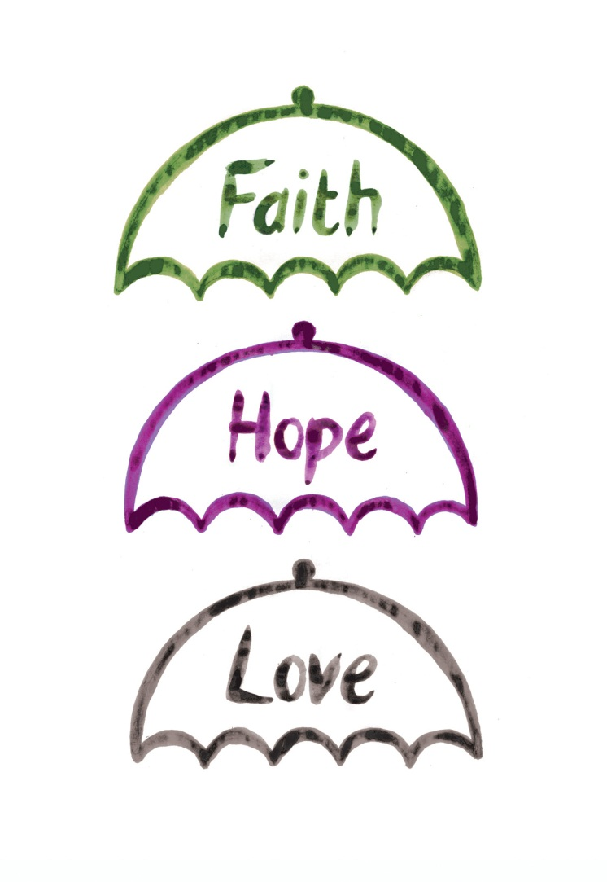
Faith, Hope, and Love
Teaching and learning can be grounded in Christian theology.
“What If Learning” expresses this in terms of faith, hope, and love.
What If Learning: Connecting Christian Faith and Teaching
Notes:
Faith, hope, and love are umbrella terms under which are grouped much of what Christians believe. The Apostle Paul listed faith, hope, and love as the “big three” in 1 Corinthians 13:13, “And now these three remain: faith, hope, and love. But the greatest of these is love” (niv).

Slide 5
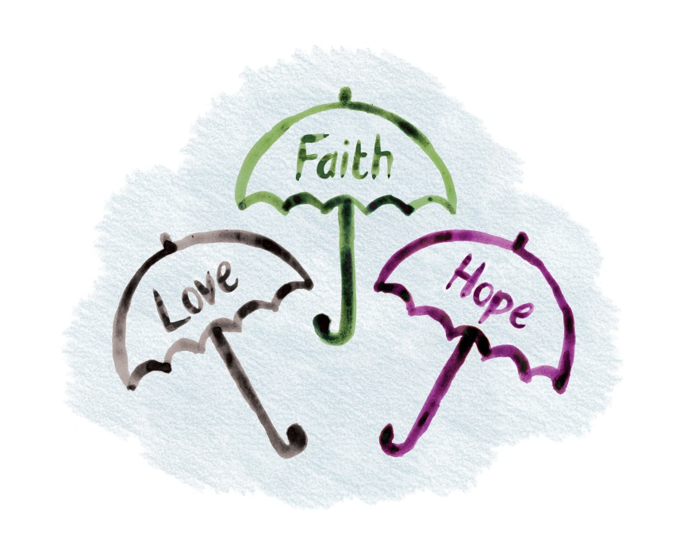
Faith Is . . .
an attitude of trust in God;
what is believed about God, the world, others, and myself (beliefs/doctrines, creeds);
a commitment to God and others; and
a faithful way of life that flows
from these beliefs, attitudes,
and commitments.
What If Learning: Connecting Christian Faith and Teaching
Notes:
Faith is often described as intellectual assent to a certain set of beliefs. For Christians, that is only one aspect of faith, for faith is not just what is believed; it is also putting trust in the God whom those beliefs describe. It is a matter of heart and mind. Faith is also a lifestyle, the living out of what is believed.
The word faith conveys the sense of security associated with trusting a reliable person. For Christians, faith is a precious gift and a response to the grace (undeserved love) of God; it is not just something people generate themselves. Christian faith is faith in the person and work of Christ, and a life of faith is lived with the help of the Holy Spirit. Faith reflects an unreserved commitment to following Christ, whatever life may bring. One way in which faith is expressed is in certain core beliefs concerning God and people’s relationship with him. Most churches have these beliefs written down in creeds (i.e., summary statements of the Christian faith). However, reciting creeds is not enough, for faith includes a relationship of trust and a lifestyle that lives out both the relationship and the beliefs. Many Christians may not be able to explain key Christian beliefs in detail, but their faith is expressed in their behavior, practices, and a way of living arising out of their hope, love, and trust in God.
Activity: Ask teachers for examples of
faith as a belief (name a Christian belief);
faith as an attitude (any attitudes or feelings associated with faith); and
faith expressed in way of life (an action that is the consequence of a Christian belief) .

Slide 6
Hope Is . . .
a confidence in God and his promises;
confidence that, in Christ, “Good is stronger than evil; love is stronger than hate; light is stronger than darkness; life is stronger than death” (Bishop Desmond Tutu); and
the basis of an optimistic but realistic lifestyle that is good news for today and hope for tomorrow.
What If Learning: Connecting Christian Faith and Teaching
Notes:
Hope is often mistaken for naive, wishful thinking or a cheery optimism that things will work out okay. Christian hope is different: it is not ultimately about feelings or even a person’s faith, but is based on the actions and character of God.
Christian hope is about learning to place a growing confidence in God, who does not fail and who keeps his promises. It centers on Christ, who triumphed over death and sin by his death and resurrection, demonstrating that God’s love is stronger than evil and that death does not have the last word. This victory points Christians to the future, to the hope and the promise that one day the world will be made new without sorrow or pain, and sin will be no more. This hope inspires a different lifestyle now as Christians are called to make this world less sorrowful, healing the brokenness created by sin, bringing hope, being coworkers with God in restoring his world. This work begins now, but God will make it complete when the world is renewed. What we do now matters (1 Corinthians 15:58). The life we live now both changes the present and acts as a signpost to a better future. Schools can become “signpost communities,” places of justice and love, places where the broken are mended, places that point to a better way by the way life and learning within the school community are organized and practiced.
Hope keeps people going in hard times and is linked to perseverance. Hope is communal: Christians do not hope alone but are called to support each other.
Activity: In what concrete ways (give examples) could a school be a signpost community—a community that pointed to a better way, a better future by the way life and learning in the school are organized and practiced?

Slide 7
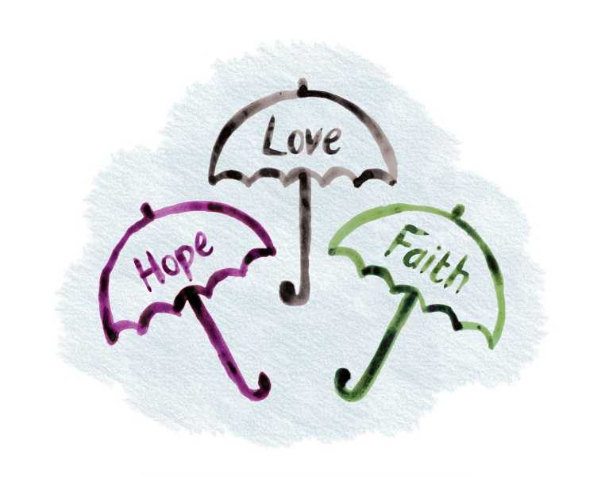
Love Is . . .
a deep feeling and attachment to God and others;
an act of will and a choice about how we live;
a move from self-centeredness to seeking the well-being of others; and
God’s character: “God is love” (1 John 4:8b).
What If Learning: Connecting Christian Faith and Teaching
Notes:
The Bible celebrates all kinds of love, from families to erotic poetry. When the New Testament speaks of “faith, hope, and love,” however, the kind of love in view is the kind that involves turning away from self-centeredness and seeking the well-being of others. Jesus centered his teaching around a call to love God with all that we are and love our neighbor as ourselves. In other words, we are to focus not just on our own needs and desires, but on seeking the delight of God and those around us. This love is kind and patient, humble and persevering, never selfish or rude, and it does not bear a grudge.
Christians believe that this kind of love echoes the character of God: “God is love,” as one passage puts it. Therefore this kind of love should increasingly characterize a Christian’s way of being in the world, our way of treating other people and the world around us.
Teaching and learning can be part of our desire to live out love in our lives, for we can design teaching and learning to turn us from preoccupation with self to being unselfish, from taking little notice of others and God’s world to attentive care.
Activity: Look at 1 Corinthians 13:4–8a : “Love is patient, love is kind. It does not envy, it does not boast, it is not proud. It does not dishonor others, it is not self-seeking, it is not easily angered, it keeps no record of wrongs. Love does not delight in evil but rejoices with the truth. It always protects, always trusts, always hopes, always perseveres. Love never fails” (niv). Which of these aspects of love do our schools need most today?”

Slide 8
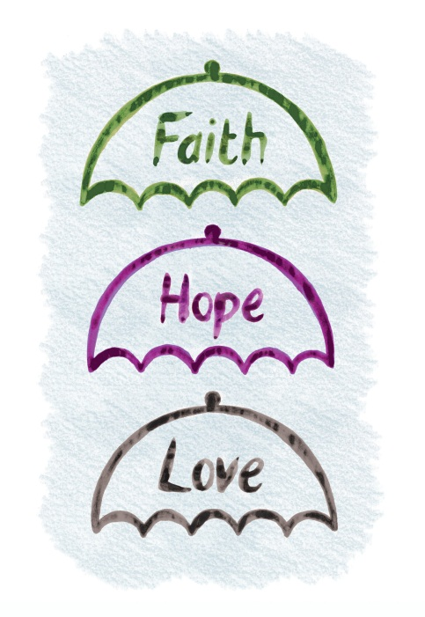
Umbrella Terms
Faith, hope, and love cover a wide range of beliefs, attitudes and behaviors. People can grow in faith, hope, and love as they develop spiritually. It is an ongoing process, so we have expressed them as movements:
Toward respect and reverence
Toward love and forgiveness
What If Learning: Connecting Christian Faith and Teaching
Notes:
Faith, hope, and love cover a range of beliefs, attitudes, actions, and lifestyles. There is never a point at which a Christian can check off faith, hope, or love and feel that they have “done that.”
Faith, hope, and love are ways of living and being that we grow into over many years. In one sense faith, hope, and love are too big, they are beyond us, but everyone can make some progress in these areas, and with the help of God we can change and grow.
Bearing this in mind, we have expressed the different aspects of faith, hope, and love as movements “toward” certain attitudes, behaviors, and ways of thinking—for example: toward self-control and peace, toward encouragement and working for change.
Activity: you might like to use the Umbrella activity at this point (http://www.whatiflearning.com/training/umbrella-exercise). To give teachers something to refer to, you can print the articles on faith, hope, and love as indicated in the instructions, or if you want something smaller, you can print the notes of slides 5, 6, and 7.

Slide 9
Progressing in faith, hope, and love
Progress is a continuous movement.
The Bible talks of change as both the work of the Holy Spirit and effort on our part.
The Apostle Paul describes the change as daily putting on the “clothes” from God’s wardrobe. Those “clothes” include love, patience, humility, and gentleness.
What If Learning: Connecting Christian Faith and Teaching
Notes:
This idea of putting on the clothes from God’s wardrobe conveys the continuous nature of growing in love and other virtues. We get dressed daily, it’s not something we ever complete.
“Therefore, as God’s chosen people, holy and dearly loved, clothe yourselves with compassion, kindness, humility, gentleness and patience. Bear with each other and forgive one another if any of you has a grievance against someone. Forgive as the Lord forgave you. And over all these virtues put on love, which binds them all together in perfect unity” (Colossians 3:12–14 niv).
On the website you will see growth in faith, hope, and love expressed as a continuous movement—for example, “toward giving and serving others,” “toward appreciation and gratitude.” That is not to say everyone is grasping and ungrateful. It is to say we can all live a way of life that is more giving and more thankful. The movements just describe the direction in which Christianity takes people.
In the Bible, growth is a cooperative venture with God. It is both our effort and the work of the Holy Spirit.
This website invites staff and students to teach and learn within a Christian framework; it gives examples of how we can provide opportunities to practice language in a giving context, to practice math within a serving context, to practice PE within a context of respect and self-control. The changes are often small, but they can help bring ethos, curriculum, and pedagogy in line so that what “frames” our lessons does not accidentally clash with a Christian ethos.

